Slide 1
Smart to Smart-er City: Vision and Challenges - A Survey
Presented by:
Asima Nisar
Ph.D. – CS
(Communication & Networks)

Slide 2
Agenda
Preamble
Smart City: Need
Smart City: Core Idea & Figure 1
Smart City: Origin
Smart City: Building Blocks & Figure 2
Available ICT Technologies (RFID, NFC, LTE)
Smart City: Future Trends & IoE & Figure 3
Conclusion & Open Issues

Slide 3
Preamble
Integration of modern urbanization, demographic shifts, sustainable economic development, innovative ecosystems, improved stakeholder collaboration, enhanced urge to improve quality of life, promotion of renewable and sustainable energy, civic engagement, and emerging technological advancements results in reshaping the infrastructure of a traditional city from smart to smart-er every day.

Slide 4
Smart City: Need
We live in a world experiencing economic turmoil, climate change, aging populations, and rapid urbanization. Simultaneously, we also live in the midst of tremendous technological innovations that have the potential to address the issues that challenge every city [5].

Slide 5
Smart City: Core idea
A ‘Smart City’ is intended as an urban environment which supported by pervasive ICT (Information and Communication Technology) systems, is able to offer advanced and innovative services to citizens in order to improve the overall quality of life. ICT plays a key role by interconnecting all the actors of a Smart City and by supporting the provision of seamless ubiquitous services. ICT platform has become the ground floor of the Smart City foundation [9].

Slide 6
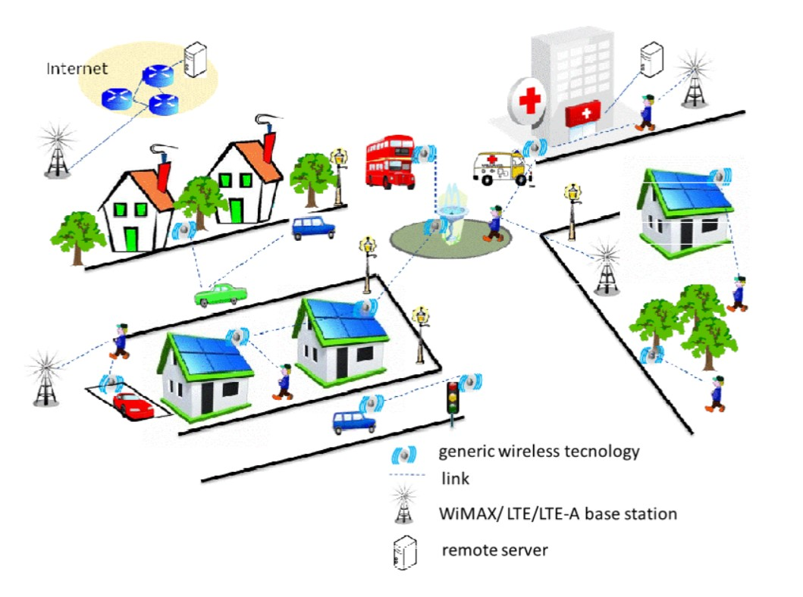
Smart City: An Example [9] - Figure 1

Slide 7
Smart City: Origin
Origin of Smart Cities is based mainly on two factors [4]:
Firstly, the increase in world population and its growing migration from rural areas to urban centers.
Secondly, there is a concern about the shortage of natural resources, which may compromise in the coming years the global supply to the world population, along with concerns about the environment and climate change.

Slide 8
Smart City: Building Blocks
Components of a smart city are listed here with relevant aspects of urban life [4], [7]:
Smart Economy: Industry; Competitiveness
Smart People: Education; Social and Human Capital
Smart Governance: e-Democracy; Citizen Participation
Smart Mobility: Logistics & Infrastructure; Transport & ICT
Smart Environment: Efficiency & Sustainability; Natural Resources
Smart Living: Security & Quality; Quality of Life

Slide 9
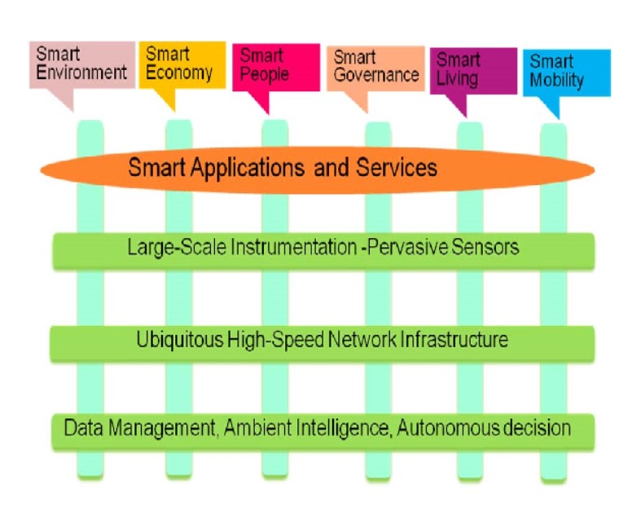
Smart City: Building Blocks [10] – Figure 2

Slide 10
Available ICT Technologies
List of available ICT technologies is as under:
IoIT (Internet of Important Things)
Capillary M2M systems: Short Range Systems
Cellular M2M systems: Long Range Systems
IoIT include objects important to the well-being and safety of humans will likely to be connected first.
Capillary M2M (Machine-to-Machine) systems include short range systems like WSNs (Wireless Sensor Networks). WSNs mainly include [6]:
RFID: Radio Frequency IDentification: Unidirectional
NFC: Near Field Communication: Bidirectional

Slide 11
RFID: Radio Frequency IDentification
RFID consists of an RFID tag (which can be either passive or active) where data is stored and an RFID reader; enabling it to read data from the tag’s memory. Passive tags are inexpensive; hence can be deployed in very large numbers for pervasive sensing. Passive nature of these tags translates to low cost and low power consumption as these tags only need to be powered when needed. RFID enables a range of applications for Smart Cities, such as:
Localizing and tracking of objects
Healthcare applications
Asset management
Smart parking, etc. [8]

Slide 12
NFC: Near Field Communication
NFC provides bidirectional very short communication range usually in centimeter range. NFC is used in mobile and similar devices; also integrated into smartphones, hence has enabled smart living. Following are the real-world examples of NFC applications, within context of the Smart Cities:
Smart energy metering
Data acquisition and control
City touristic surfing
Smart car parks, etc. [8]

Slide 13
LTE: Long Term Evolution
Cellular M2M (Machine-to-Machine) systems include long range systems like ETSI M2M, 3GPP LTE as well as IEEE 802.16 (WiMAX) [6].
LTE has been a main enabler of high performance M2M applications, due to coverage, high throughput, and low latency [8].

Slide 14
Smart City: Future Trends
Smart City is the potential future for every city and town. The vision of future Smart City is a city with a pervasive overlay of ICT connecting things, organizations, and people. For example, sensors connect cars to transportation management centers that analyze day-to-day traffic flow data and provide what-if scenarios in case of events or accidents [5].

Slide 15
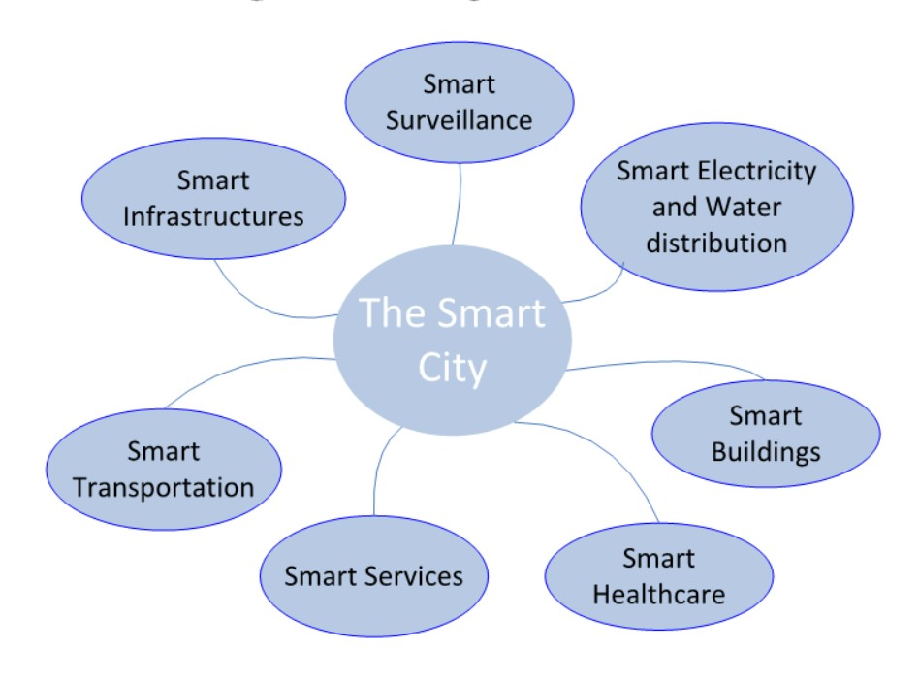
Sensing in Smart Cities [8] – Figure 3

Slide 16
IoE: Internet of Everything
IoE will transform city life and help cities become smart cities [5]; even smart-er. The IoE will connect people, data, things, and processes in networks of billions or even trillions of connections. There are three key ways in which the IoE will significantly impact our lives [5]:
IoE will automate connections.
IoE will enable fast personal communications and decision making.
IoE will uncover new information.

Slide 17
Conclusion
Smart Cities are a future reality for municipalities around the world. These cities will use the power of ubiquitous communication networks, highly distributed wireless sensor technology, and intelligent management systems to solve current and future challenges and create existing new services. Smart city officials will be essential visionary leaders who drive Smart City progress using public-private partnerships to invest in scalable projects, smart regulation to connect city laws to new digital realities, and innovation clusters to create jobs and vibrant economies [5]. The Smart cities’ topic is still largely under exploration [2].

Slide 18
Open Issues
Energy management [1]
Strategic planning [2]
Congestion problems [3]
New processing & storage systems and Standards [4]
Information-centric ICT platforms [9]
Framework of IoE [5]

Slide 19
Question(s) & Answer(s)
THANK YOU..

